Slide 1

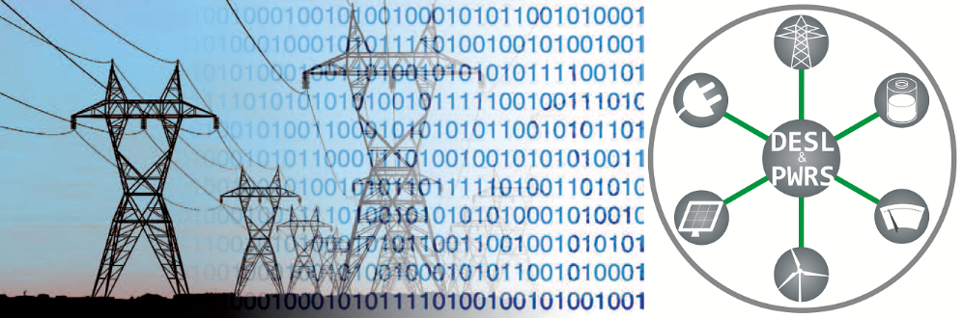
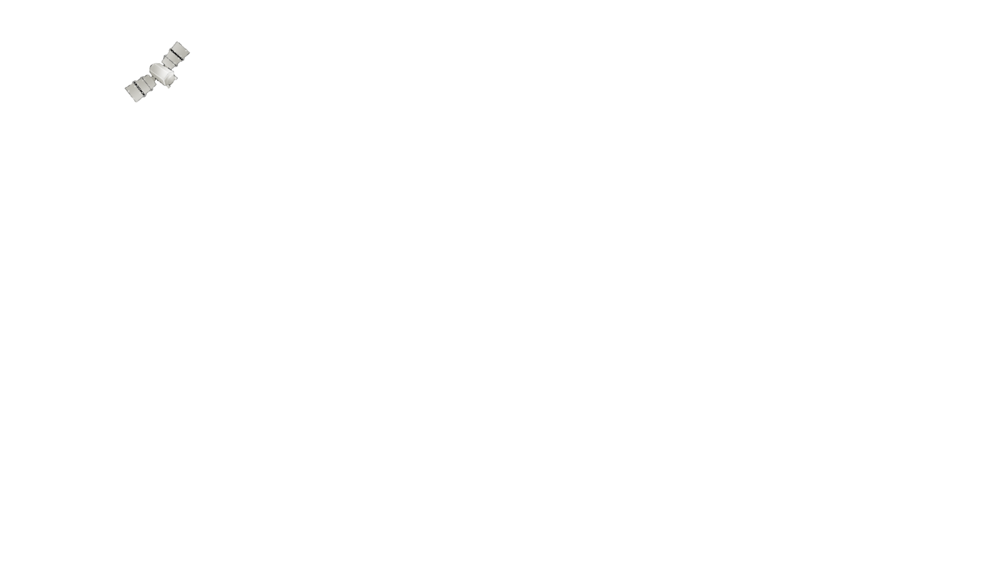
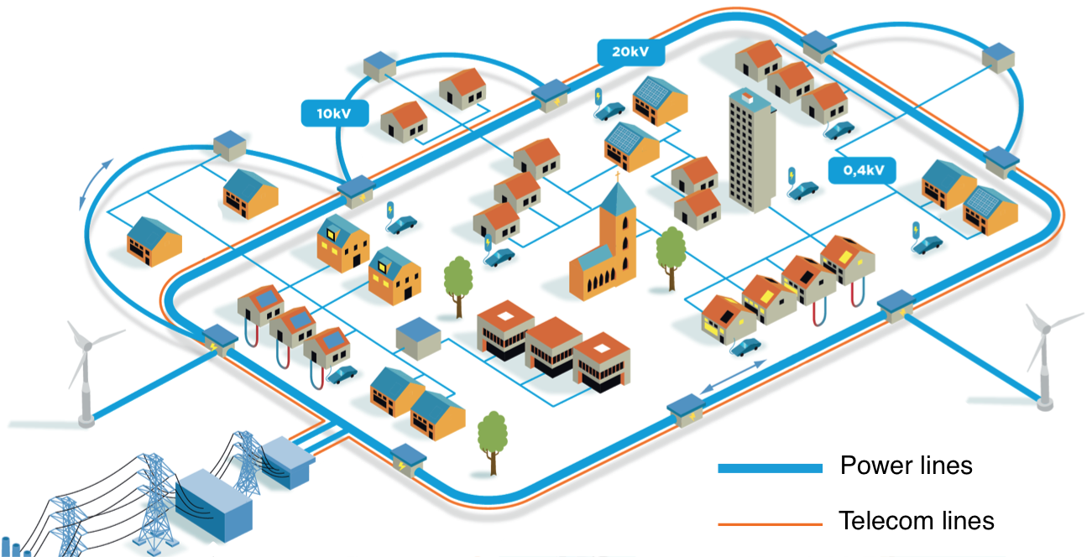


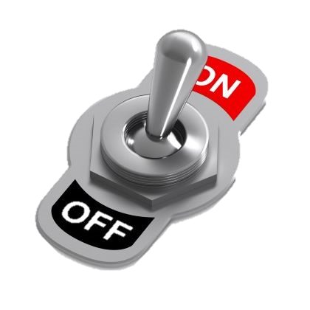
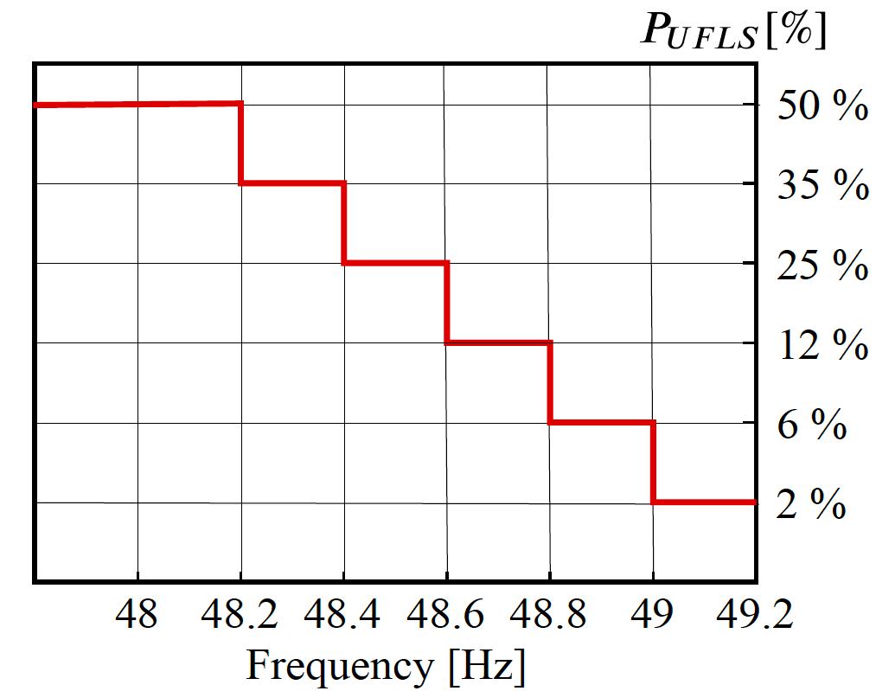
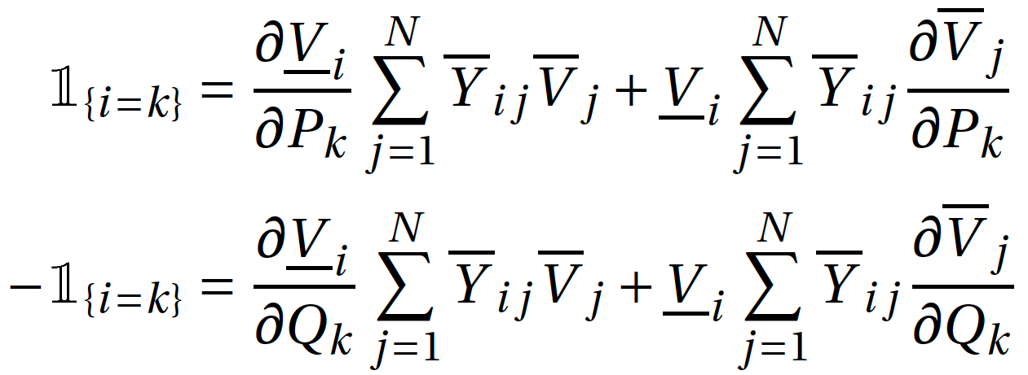
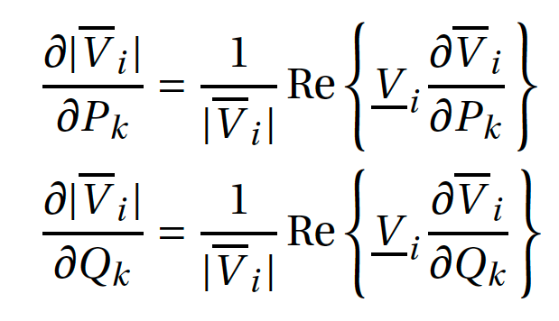
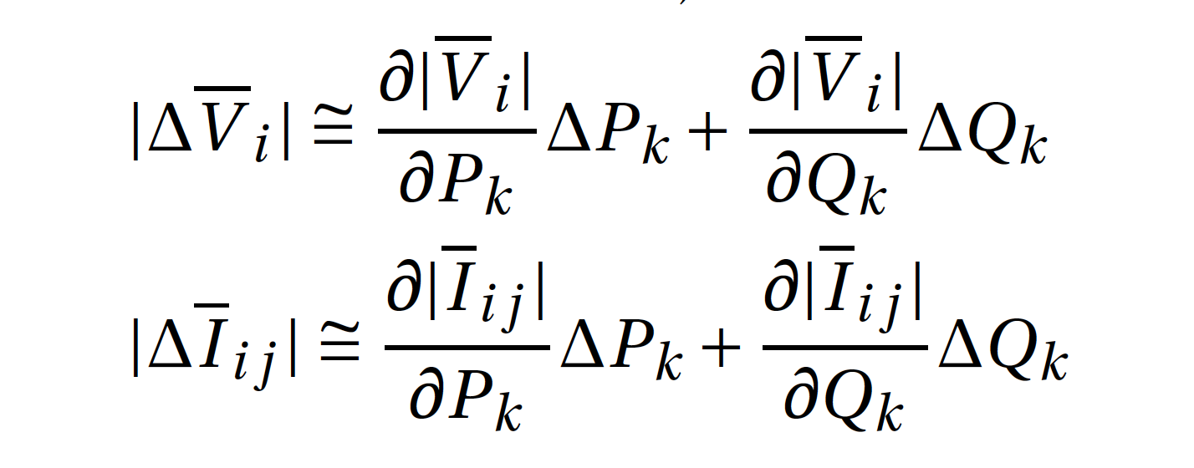
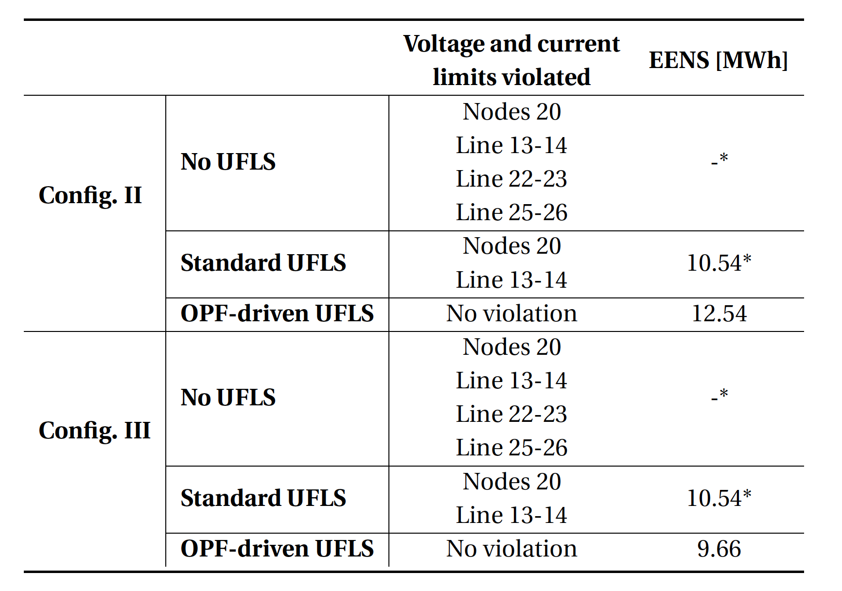
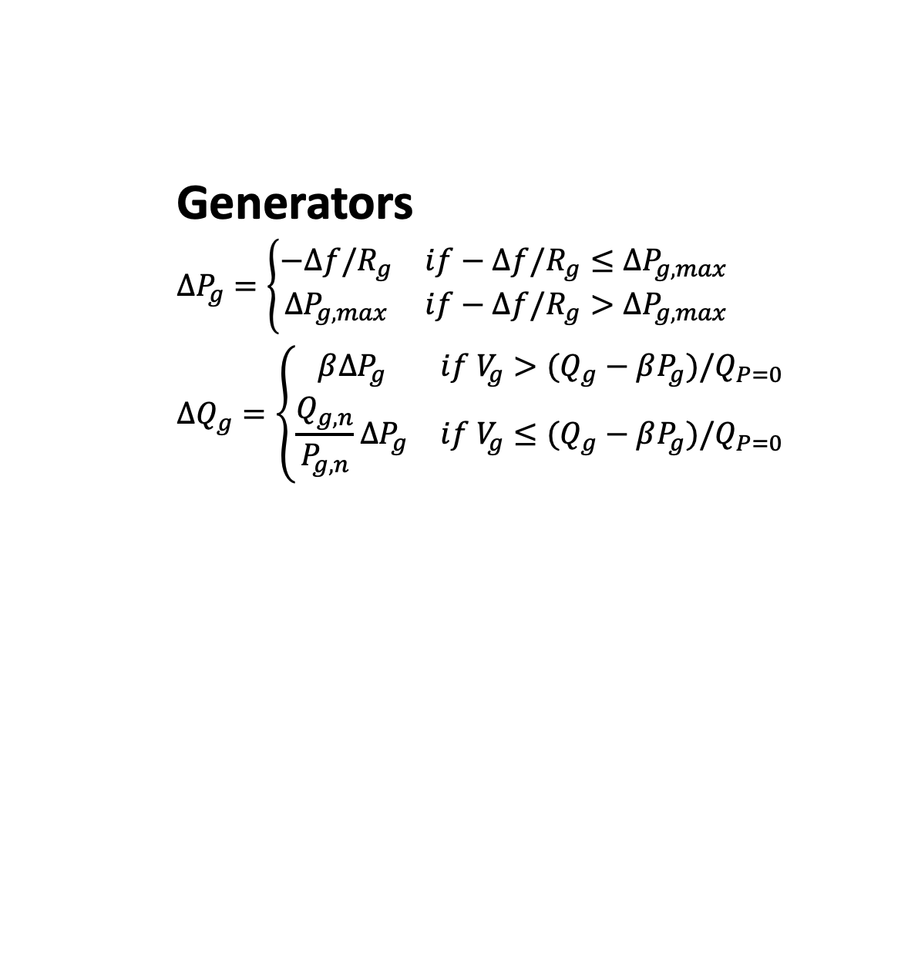
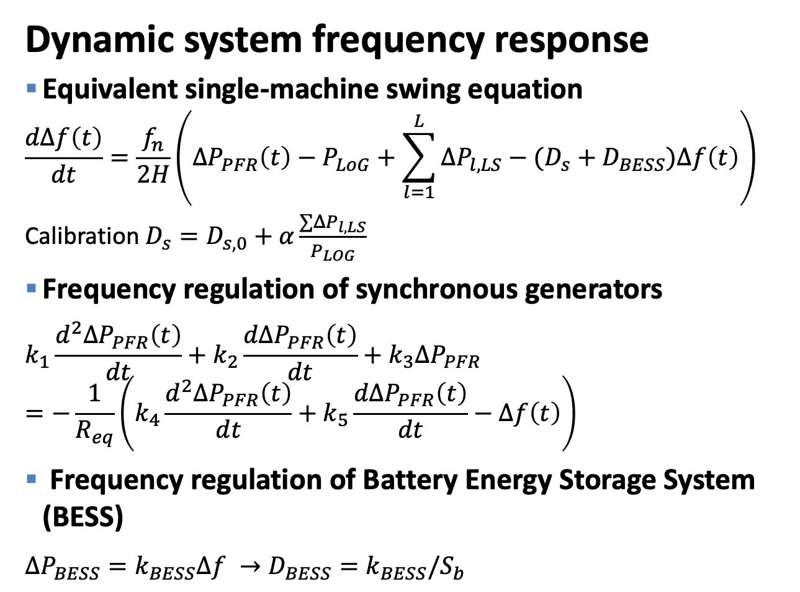
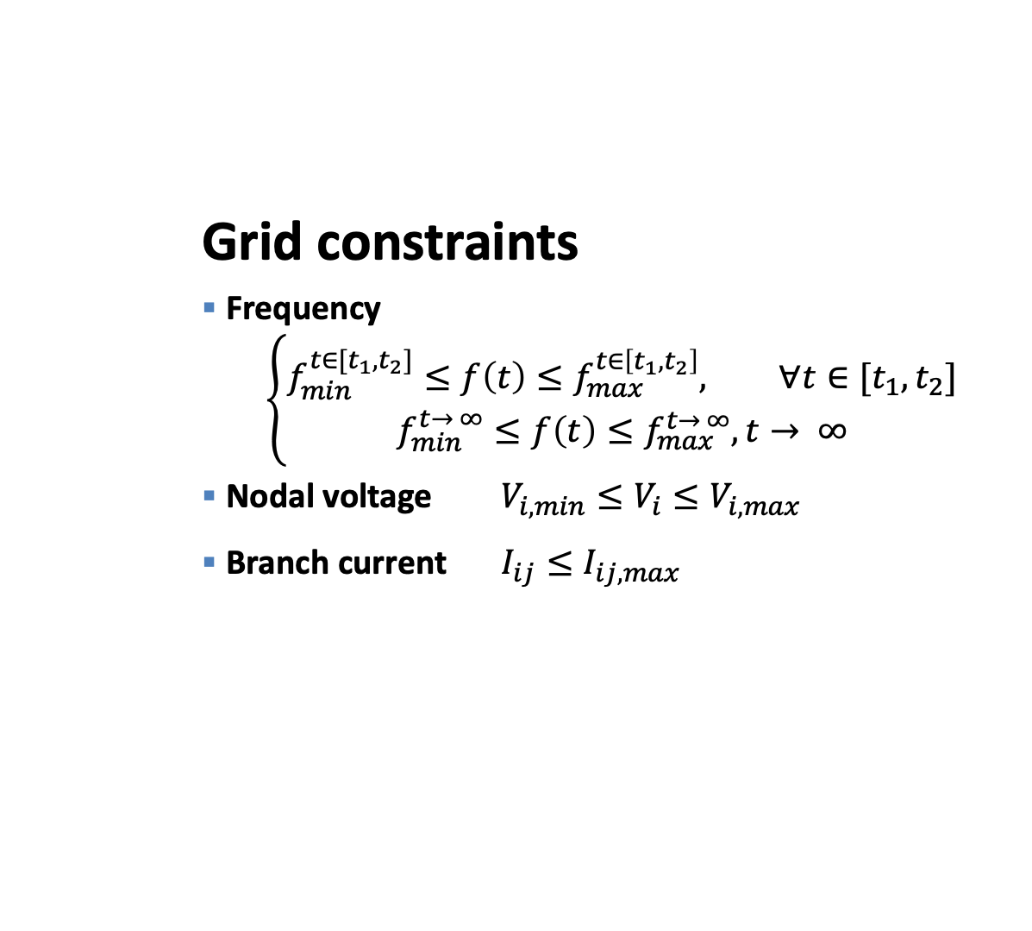
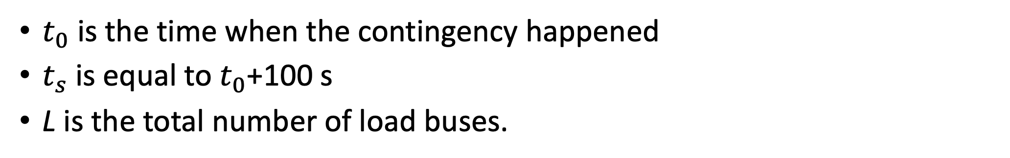
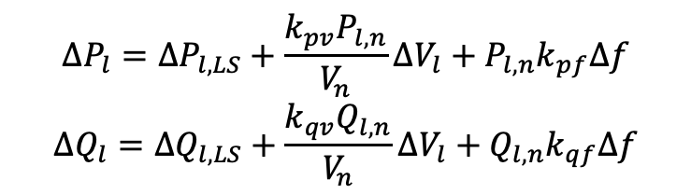
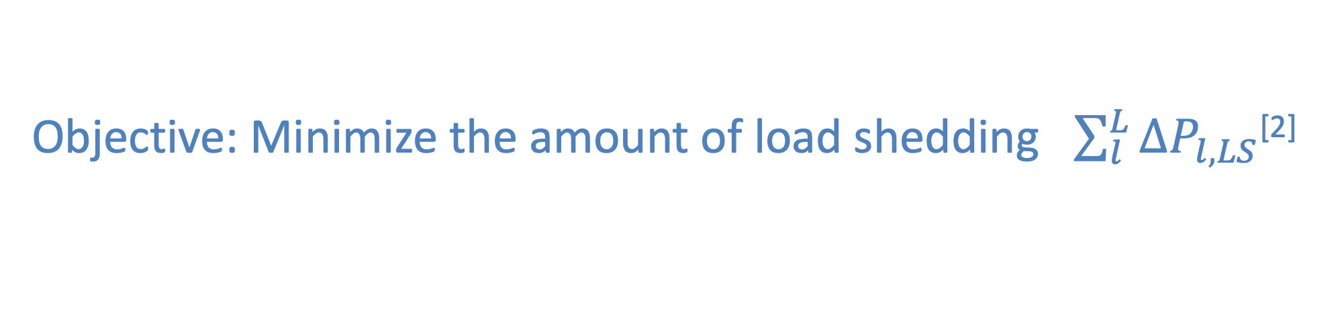

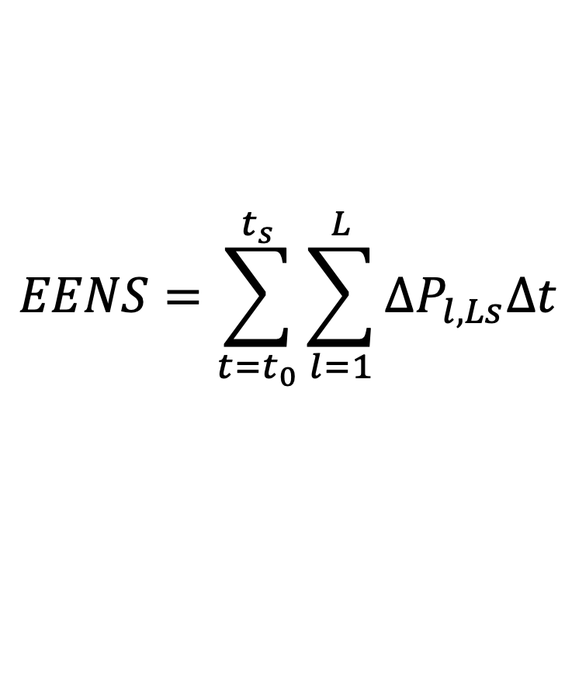
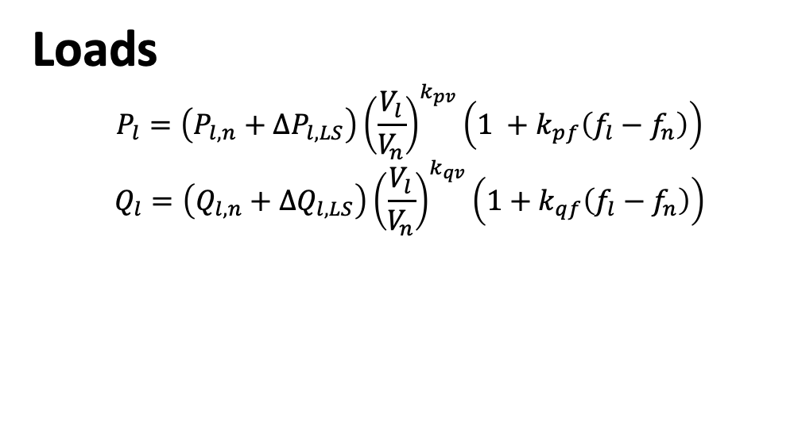
DISTRIBUTED ELECTRICAL
SYSTEMS LABORATORY
Prevention of Large-scale Blackouts in Modern Power Systems
Yihui Zuo, Asja Derviškadić, Mario Paolone
Context
Aims and Contributions
Frequency Stability
Blackout Event of September 28, 2016, Australia^{[1]}
Develop an Optimal Power Flow (OPF)-driven Under-frequency Load Shedding (UFLS) scheme suitable for low-inertia power grids hosting large shares of renewables.
Obj: Minimize the amount of shed load while ensuring a safe trajectory of the system frequency and prevent nodal voltages and branch currents from violating feasible bounds.
Compare the proposed UFLS scheme with the one recommended by the European Network of Transmission System Operators (ENTSO-E).
Tornadoes in South Australia (SA) tripped multiple 275 kV transmission circuits, and resulted in multiple faults in quick succession.
SA pre-black-out generation mix
The voltage dips due to the faults triggered protection on several wind farms to runback about 456 MW of wind generation.
The reduction in wind farm output was compensated by an increase in power imported from Victoria However, the import reached a level that tripped the interconnector on loss of synchronism protection.
System frequency
Frequency falling so fast that load shedding schemes were unable to stop the fall, resulting in a blackout.
ROCOF $≃−$6.25 Hz/s
OPF-driven UFLS Method
Performance Assessment
Enhance performance of emergency operational practice in TSOs’ control room
IEEE 39-bus low-inertia power grid time-domain full-replica dynamic model
Time
Synchronization
Phasor Measurement
Unit (PMU)
4 type-III wind power plants replace 4 synchronous generators in IEEE 39-bus benchmark power system.
A 225 MW/175 MWh BESS
A simulated PMU for each bus
Time-domain dynamic models are open sourced: https://github.com/DESL-EPFL/
Execute on Opal-RT eMEGAsim Real Time Simulator
Phasor Data
Concentrator (PDC)
SCADA
UFLS strategy
Real-time
State Estimation
Network topology
and parameters
Contingency Analysis
+
Proposed UFLS
Objective: Minimize the amount of load shedding $\sum_{l}^{L}{ΔP_{l,LS}}$^{[2]}
Compare with the UFLS scheme recommended by ENTSOE^{[3]} (standard UFLS)
Grid constraints
Frequency
$$\left\{\begin{aligned}f_{min}^{t∈[t_{1},t_{2}]}≤f\left(t\right)≤f_{max}^{t∈\left[t_{1},t_{2}\right]}, ∀t∈[t_{1},t_{2}] \\ f_{min}^{t→ ∞}≤f\left(t\right)≤f_{max}^{t→ ∞},t→ ∞\end{aligned}\right.$$
Nodal voltage $V_{i,min}≤V_{i}≤V_{i,max}$
Branch current $I_{ij}≤I_{ij,max}$
Dynamic system frequency response
Equivalent single-machine swing equation
$$\frac{dΔf\left(t\right)}{dt}=\frac{f_{n}}{2H}\left(ΔP_{PFR}\left(t\right)−P_{LoG}+\sum_{l=1}^{L}{ΔP_{l,LS}}−(D_{s}+D_{BESS})Δf\left(t\right)\right)$$
Calibration $D_{s}=D_{s,0}+α\frac{∑ΔP_{l,LS}}{P_{LOG}}$
Frequency regulation of synchronous generators
$$k_{1}\frac{d^{2}ΔP_{PFR}\left(t\right)}{dt}+k_{2}\frac{dΔP_{PFR}\left(t\right)}{dt}+k_{3}ΔP_{PFR}=−\frac{1}{R_{eq}}\left(k_{4}\frac{d^{2}ΔP_{PFR}\left(t\right)}{dt}+k_{5}\frac{dΔP_{PFR}\left(t\right)}{dt}−Δf\left(t\right)\right)$$
Frequency regulation of Battery Energy Storage System (BESS)
$ΔP_{BESS}=k_{BESS}Δf →D_{BESS}=k_{BESS}/S_{b}$
Contingency: tripping of G4
485 MW generation power tripped
Causes several nodal voltage and branch currents limits be violated if no UFLS is applied.
Dynamic OPF: frequency is tracked in time-domain.
Generators
$${ΔP}_{g}=\left\{\begin{matrix}−Δf/R_{g} & if−Δf/R_{g}≤{ΔP}_{g,max} \\ {ΔP}_{g,max} & if−Δf/R_{g}>{ΔP}_{g,max}\end{matrix}\right.$$
$${ΔQ}_{g}=\left\{\begin{matrix}β{ΔP}_{g} & if{ V}_{g}>(Q_{g}−βP_{g})/Q_{P=0} \\ \frac{Q_{g,n}}{P_{g,n}}{ΔP}_{g} & if{ V}_{g}≤(Q_{g}−βP_{g})/Q_{P=0}\end{matrix}\right.$$
Nodal voltages and branch currents
Obtained using sensitivity coefficients^{[2]} computed as a function of the system state and the system admittance matrix.
Metric: Expected Energy Not Served (EENS)
Loads
$$P_{l}=\left(P_{l,n}+ΔP_{l,LS}\right){\left(\frac{V_{l}}{V_{n}}\right)}^{k_{pv}}\left(1 +k_{pf}\left(f_{l}−f_{n}\right)\right)$$
$$Q_{l}=\left(Q_{l,n}+ΔQ_{l,LS}\right){\left(\frac{V_{l}}{V_{n}}\right)}^{k_{qv}}\left(1+k_{qf}\left(f_{l}−f_{n}\right)\right)$$
$$EENS=\sum_{t=t_{0}}^{t_{s}}{\sum_{l=1}^{L}{ΔP_{l,Ls}Δt}}$$
$t_{0}$ is the time when the contingency happened
$t_{s}$ is equal to $t_{0}$+100 s
L is the total number of load buses.
$$ΔP_{l}=ΔP_{l,LS}+\frac{k_{pv}P_{l,n}}{V_{n}}ΔV_{l}+P_{l,n}k_{pf}Δf$$
$$ΔQ_{l}=ΔQ_{l,LS}+\frac{k_{qv}Q_{l,n}}{V_{n}}ΔV_{l}+Q_{l,n}k_{qf}Δf$$
Results
System Frequency
Frequency Nadir
48.95 Hz for Standard UFLS (+200mHz)
49.61 Hz for OPF-UFLS (+800mHz)
Line 13-14
Line 22-23
Low-inertia 39-bus with BESS vs without BESS
48.76 Hz
Post-contingency Nodal Voltages
Nodal voltage constraints
Standard UFLS: violated
Proposed UFLS: respected
Line 25-26
Line ampacity constraints
Standard UFLS: violated
Proposed UFLS: respected
* This value does not consider the EENS caused by the line tripping due to the ampacity and voltage limits violations.
[1] AEMO, “Renewable integration study: Stage 1 report - enabling secure operation of the nem with very high penetrations of renewable energy,” Australian Energy Market Operator, Tech. Rep., April 2020.
[2]
[3] ENTSO-E, “Technical background and recommendations for defence plans in the continental europe synchronous area,” Tech. Rep., 2010.
References

